Slide 1
ANGULARJS (Second meeting)
Content
Discussing about exercise at first meeting (10’)
Dealing with Scope (15’)
Directive attributes (15’)
Communicating between components (30’)
Dealing with Model (10’)
Exercise 2 (10’)

Slide 2
Exercise 1 (at first meeting)
Discussing: how to do
Show example from someone

Slide 3
1) Dealing with Scope
Creating scope
Relationship types of scope

Slide 4
Creating scope
Scopes are created by directives
Controllers set up scopes
Directives is reason to create scopes
ng-controller directive create inherited scope
Directive with shared scope mode does not create scope

Slide 5
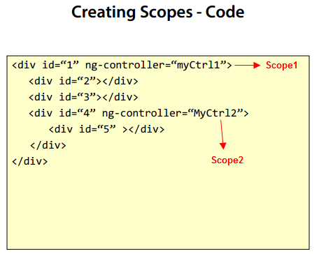
Creating scope with ng-controller
<div 5> can use properties from both myCtrl1 and myCtrl2
(inherited scope)

Slide 6
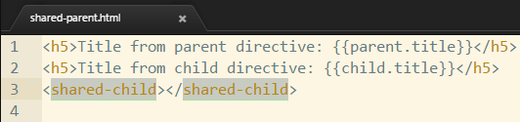
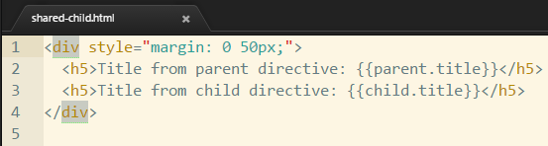
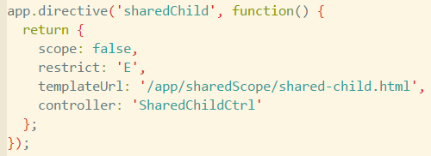
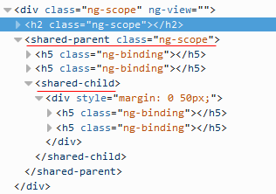
Directive with shared scope

Slide 7
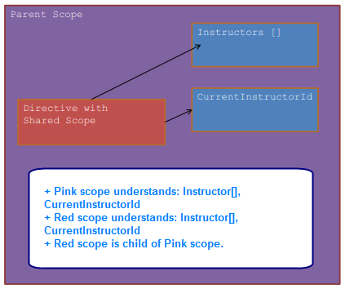
Shared scope

Slide 8
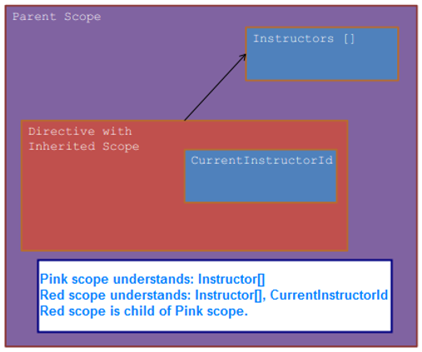
Inherited scope

Slide 9
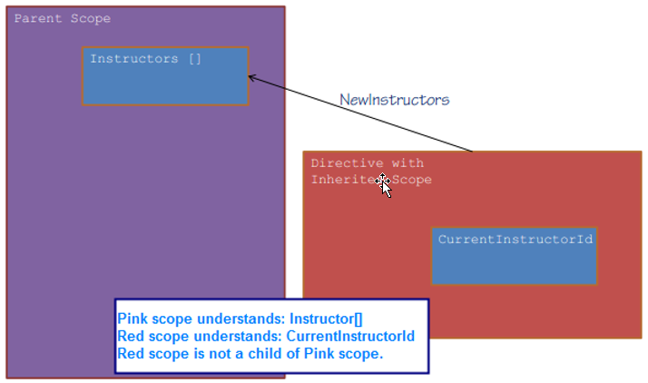
Isolated scope

Slide 10
Scope: important note
Don’t focus on scope too much. In AngularJS 2, maybe you will not see $scope.

Slide 11
2) Directive attributes

Slide 12
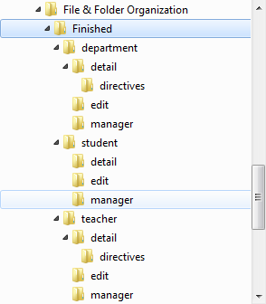
F&F Organization: coding (cont.)

Slide 13
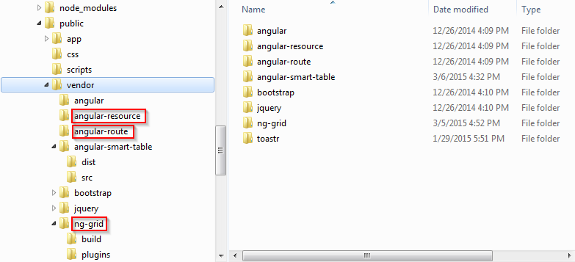
Module
Module
Separated
Injected
…

Slide 14
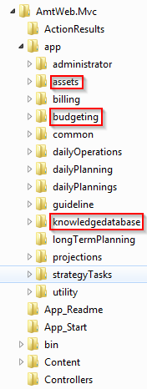
Module (cont)
Any suggestion?

Slide 15
II) Communicating between components (need to practice)
Using inherited scope
Using event
Using service

Slide 16
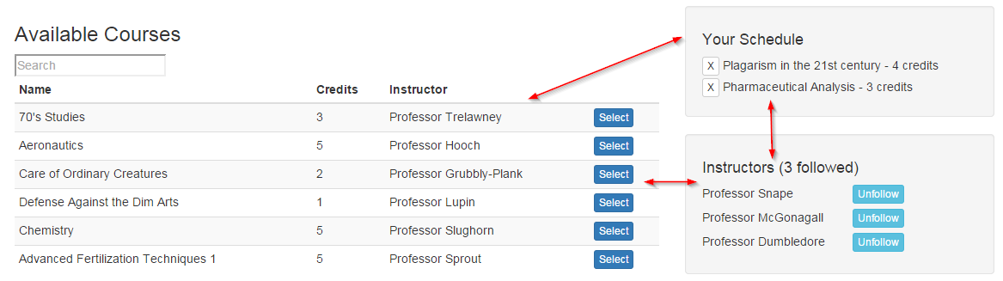
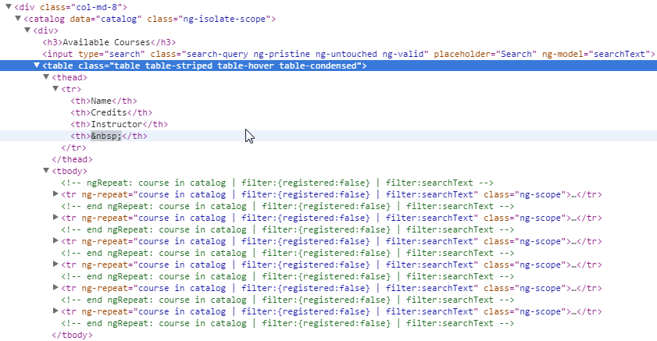
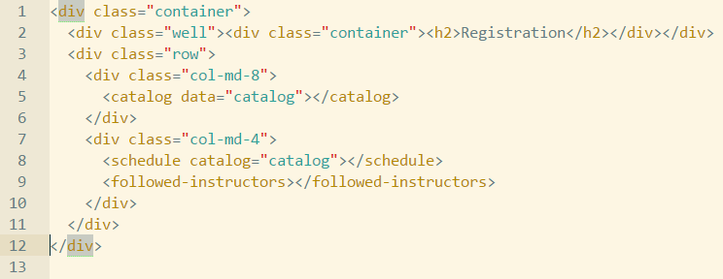
What is directive?
Normal html
Directive

Slide 17
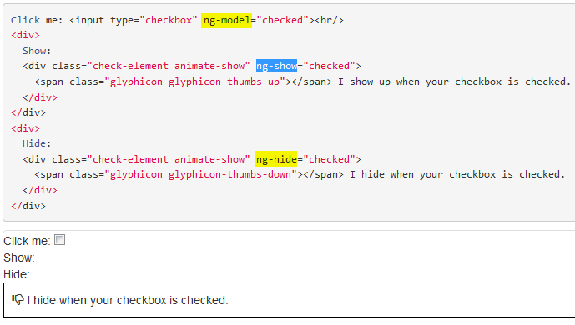
What is directive (cont)

Slide 18
When should use Directive?
Please give your idea!

Slide 19
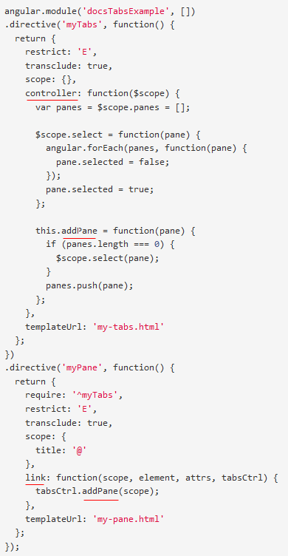
Directive: controller vs link

Slide 20
Directive: controller vs link (cont)
Best practice:
“Using controller when you want to expose an API to other directives. Otherwise use link.”

Slide 21
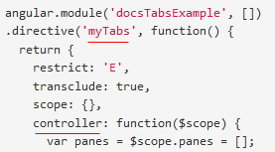
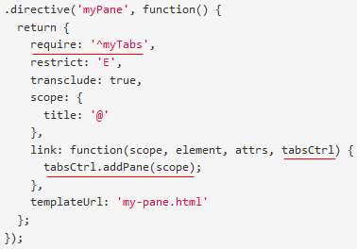
Directive: require controller(s)

Slide 22
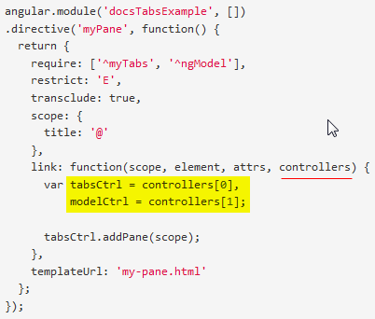
Directive: require controller (cont)
- require: 'nameOfSiblingController'
- require: '^nameOfParentController'
- require: ['nameOfSiblingController', '^nameOfParentController'] ==> multiple controllers
- require: '?nameOfController' ==> return null when can not find nameOfController instead of throw error.
- require: 'nameOfDirective' ==> Using when nameOfDirective use inner controller

Slide 23
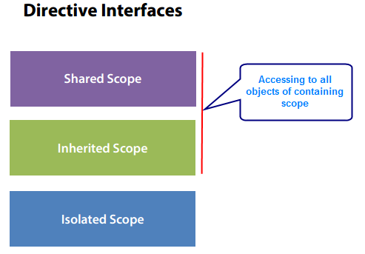
Directive interfaces

Slide 24
Directive interfaces (demo)
Parent directive ⬅ ➔ Child directive

Slide 25
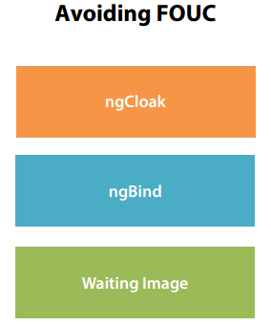
Directive: avoiding FOUC

Slide 26
Directive – Thinking declaratively (DNS)
<header>
<left-panel>
<content-panel>
<right-panel>
<customer-search>
<customer-detail>
<customer-list>
<footer>

Slide 27
III) Dealing with Model
Run webpage
Description and Requirement

Slide 28
III) Exercise 2
Run webpage
Description and Requirement

Slide 29
Q&A
Q&A

Slide 30
Thanks for joining!

